Slide 1
Density-Based Clustering Algorithms
Presented by: Iris Zhang
17 January 2003

Slide 2
Outline
Clustering
Density-based clustering
DBSCAN
DENCLUE
Summary and future work

Slide 3
Clustering
Problem description
Given:
A data set of N data items which are d-dimensional data feature vectors.
Task:
Determine a natural, useful partitioning of the data set into a number of clusters (k) and noise.

Slide 4
Major Types of Clustering Algorithms
Partitioning:
Partition the database into k clusters which are represented by representative objects of them
Hierarchical:
Decompose the database into several levels of partitioning which are represented by dendrogram

Slide 5
Other kinds of Clustering Algorithms
Density-based: based on connectivity and density functions
Grid-based: based on a multiple-level granularity structure
Model-based: A model is hypothesized for each of the clusters and the idea is to find the best fit of that model to each other

Slide 6
Density-Based Clustering
A cluster is defined as a connected dense component which can grow in any direction that density leads.
Density, connectivity and boundary
Arbitrary shaped clusters and good scalability

Slide 7
Two Major Types of Density-Based Clustering Algorithms
Connectivity based:
DBSCAN, GDBSCAN, OPTICS and DBCLASD
Density function based:
DENCLUE

Slide 8
DBSCAN [Ester et al.1996]
Clusters are defined as Density-Connected Sets (wrt. Eps, MinPts)
Density and connectivity are measured by local distribution of nearest neighbor
Target low dimensional spatial data

Slide 9
DBSCAN
Definition 1: Eps-neighborhood of a point
  N_{Eps}(p) = {q ∈D | dist(p,q) ≤ Eps}
Definition 2: Core point
  |N_{Eps}(q)| ≥ MinPts

Slide 10
DBSCAN
Definition 3: Directly density-reachable
A point p is directly density-reachable from a point q wrt. Eps, MinPts if
1) p ∈ N_{Eps}(q) and
2) |N_{Eps}(q)| ≥ MinPts (core point condition).

Slide 11
DBSCAN
Definition 4: Density-reachable
A point p is density-reachable from a point q wrt. Eps and MinPts if there is a chain of points p₁, ..., p_{n}, p₁ = q, p_{n} = p such that p_{i+1} is directly density-reachable from p_{i}
Definition 5: Density-connected
A point p is density-connected to a point q wrt. Eps and MinPts if there is a point o such that both, p and q are density-reachable from o wrt. Eps and MinPts.

Slide 12
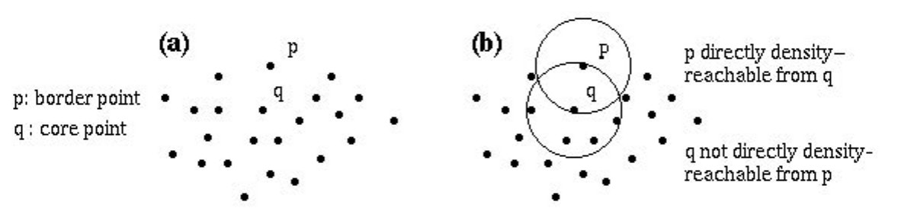

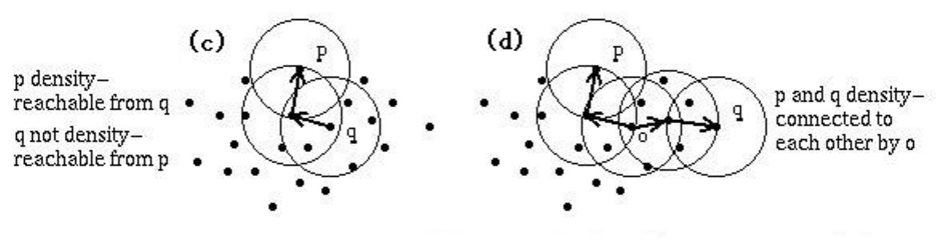
DBSCAN

Slide 13
DBSCAN
Definition 6: Cluster
Let D be a database of points. A cluster C wrt. Eps and MinPts is a non-empty subset of D satisfying the following conditions:
1) ∀ p, q: if p ∈ C and q is density-reachable from p wrt. Eps and MinPts, then q ∈ C. (Maximality)
2) ∀ p, q ∈ C: p is density-connected to q wrt. Eps and MinPts. (Connectivity)

Slide 14
DBSCAN
Definition 7: Noise
Let C₁ ,. . ., C_{k} be the clusters of the database D wrt. parameters Eps_{i} and MinPts_{i}, i = 1, . . ., k. Then we define the noise as the set of points in the database D not belonging to any cluster C_{i} , i.e. noise = {p ∈D | ∀ i: p∉ C_{i}}.

Slide 15
DBSCAN
Lemma 1:Let p be a point in D and |N_{Eps}(p)| ≥ MinPts. Then the set O = {o | o ∈D and o is density-reachable from p wrt. Eps and MinPts} is a cluster wrt. Eps and MinPts.
Lemma 2: Let C be a cluster wrt. Eps and MinPts and let p be any point in C with |N_{Eps}(p)| ≥ MinPts. Then C equals to the set O = {o | o is density-reachable from p wrt. Eps and MinPts}.

Slide 16
DBSCAN
For each point, DBSCAN determines the Eps-environment and checks whether it contains more than MinPts data points
DBSCAN uses index structures (such as R*-Tree) for determining the Eps-environment

Slide 17
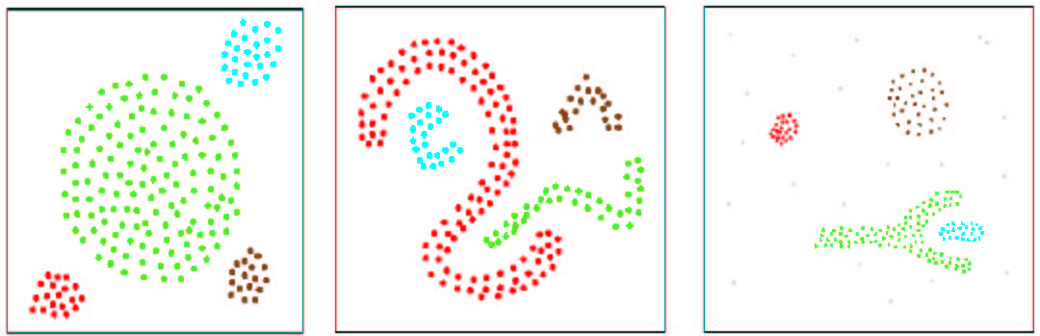
DBSCAN
Arbitrary shape clusters found by DBSCAN

Slide 18
DENCLUE [Hinneburg & Keim.1998]
Clusters are defined according to the point density function which is the sum of influence functions of the data points.
It has good clustering in data sets with large amounts of noise.
It can deal with high-dimensional data sets.
It is significantly faster than existing algorithms

Slide 19
DENCLUE
Influence Function:
  Influence of a data point in its neighborhood
Density Function:
  Sum of the influences of all data points

Slide 20
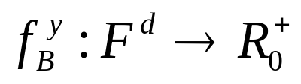
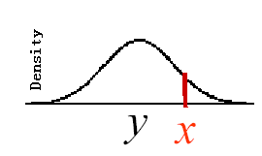
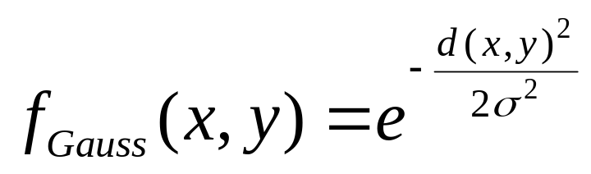
DENCLUE
Definition 1:Influence Function
The influence of a data point y at a point x in the data space is modeled by a function
e.g.:

Slide 21
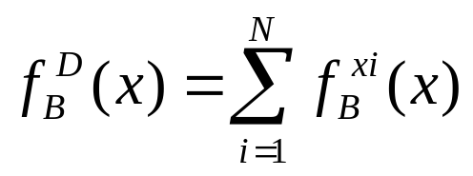
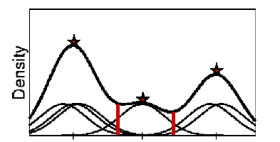
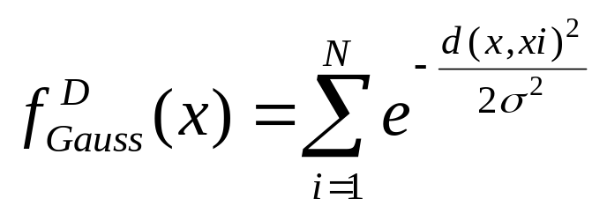
DENCLUE
Definition 2:Density Function
The density at a point x in the data space is defined as the sum of influences of all data points x
e.g.:

Slide 22
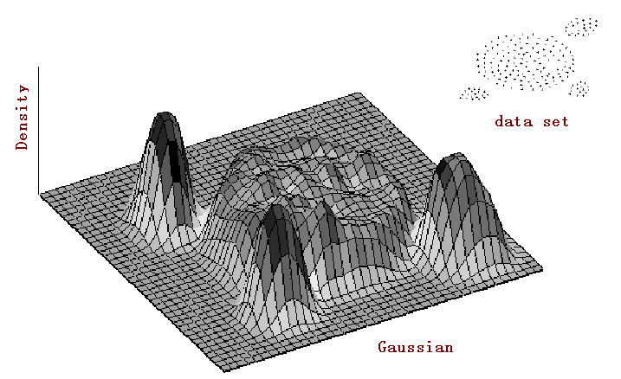
DENCLUE
Example

Slide 23
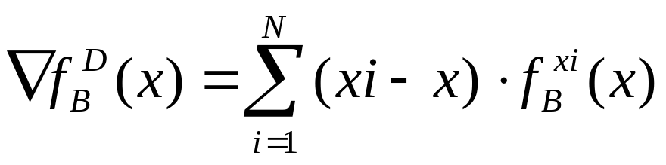
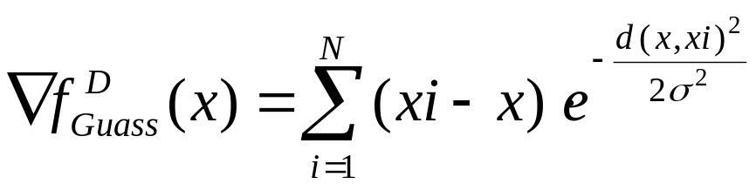
DENCLUE
Definition 3: Gradient
The gradient of a density function is defined as
e.g.:

Slide 24
DENCLUE
Definition 4: Density Attractor
A point x* ∈F^{d} is called a density attractor for a given influence function, iff x* is a local maximum of the density-function
Example of Density-Attractor

Slide 25

DENCLUE
Definition 5: Density attracted point
A point x* ∈F^{d} is density attracted to a density attractor x*, iff ∃ k ∈N: d(x^{k},x*) ≤ ε with
-x^{i} is a point in the path between x and its attractor x*
-density-attracted points are determined by a gradient-based hill-climbing method

Slide 26
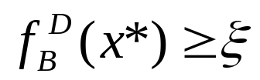
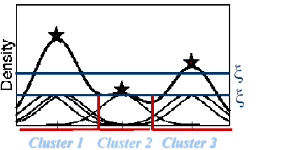
DENCLUE
Definition 6: Center-Defined Cluster
A center-defined cluster with density-attractor x*
( ) is the subset of the database which is density-attracted by x*.

Slide 27

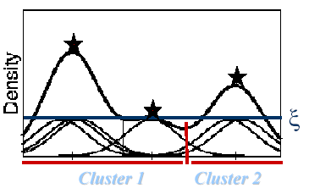
DENCLUE
Definition 7:Arbitrary-shaped cluster
A arbitrary-shaped cluster for the set of density-attractors X is a subset C⊆ D,where
1) ∀x∈C,∃x* ∈ X: x is density attracted to x* and
2) ∀x₁*,x₂*∈X: ∃ a path P⊂ F^{d} from x1* to x2* with ∀p∈P:

Slide 28
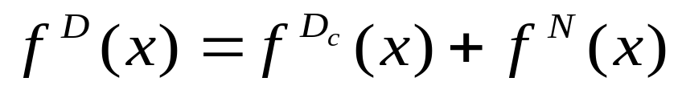
DENCLUE
Noise-Invariance
Assumption:Noise is uniformly distributed in the data space
Lemma:The density-attractors do not change when the noise level increases.
Idea of the Proof:
- partition density function into signal and noise
- density function of noise approximates a constant.

Slide 29
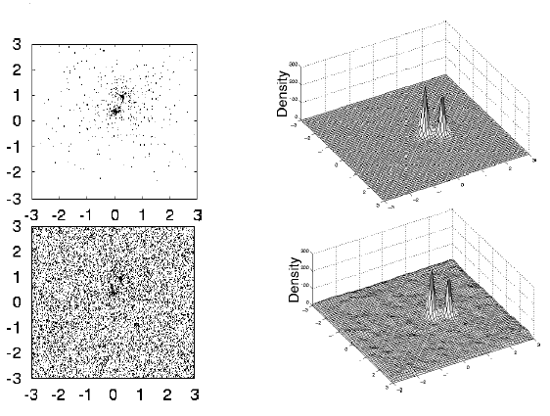
DENCLUE
Example of noise invariance

Slide 30
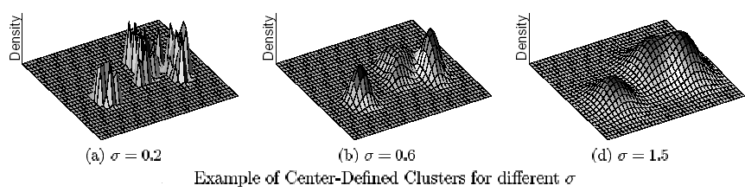
DENCLUE
Parameter-σ:
It describes the influence of a data point in the data space. It determines the number of clusters.

Slide 31
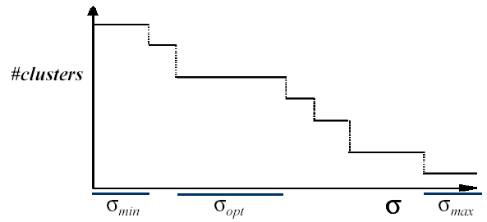
DENCLUE
Parameter-σ:
Choose σ such that number of density attractors is constant for the longest interval of σ.

Slide 32
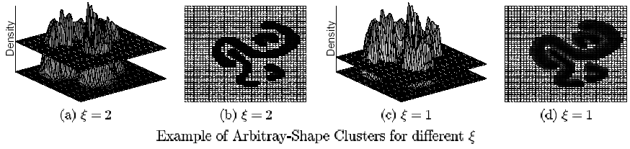
DENCLUE
Parameter- ξ
It describes whether a density-attractor is significant, helping reduce the number of density-attractors such that improving the performance.

Slide 33
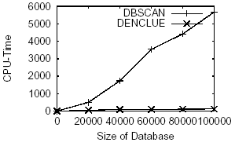
DENCLUE
Experiment
Polygonal CAD data (11-dimensional feature vectors)
Comparison between DBSCAN and DENCLUE

Slide 34
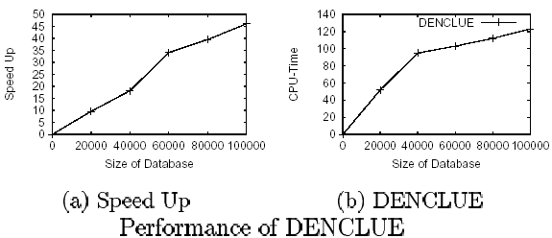
DENCLUE

Slide 35
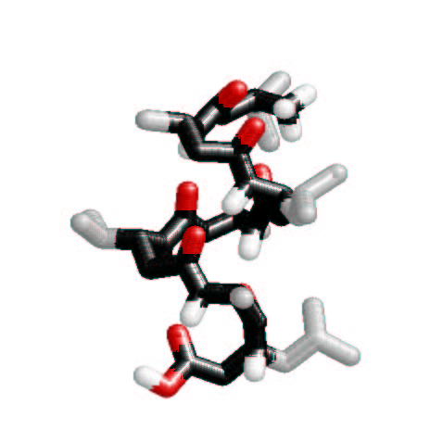
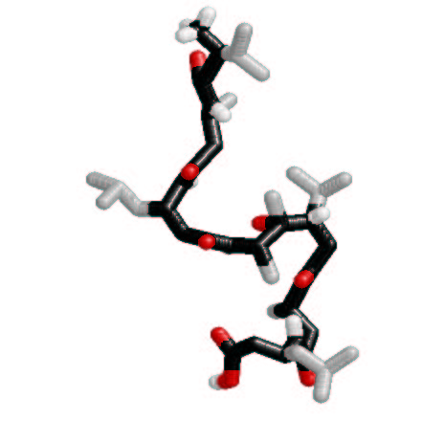
DENCLUE
Molecular biology to determine the behavior of the molecular in the conformation space (19-dimensional dihedral angle space with large amount of noise)
Folded State
Unfolded State
Folded Conformation of the Peptide

Slide 36
Summary
arbitrary shaped clusters
good scalability
explicit definition of noise
noise invariance
high dimensional clustering

Slide 37
Future work
Using density-based clustering method to deal with high dimensional dataset

Slide 38
References
[EKS+ 96] M. Ester, H-P. Kriegel, J. Sander, X. Xu, A Density-Based Algorithm for Discovering Clusters in Large Spatial Databases with Noise, Proc. 2nd Int. Conf. on Knowledge Discovery and Data Mining, 1996.
[HK 98] A. Hinneburg, D.A. Keim, An Efficient Approach to Clustering in Large Multimedia Databases with Noise, Proc. 4th Int. Conf. on Knowledge Discovery and Data Mining, 1998.
[XEK+ 98] X. Xu, M. Ester, H-P. Kriegel and J. Sander., A Distribution-Based Clustering Algorithm for Mining in Large Spatial Databases, Proc. 14th Int. Conf. on Data Engineering (ICDE’98), Orlando, FL, 1998, pp. 324-331.

Slide 39
References
J. Sander, M. Ester, H-P. Kriegel, X. Xu, Density-Based Clustering in Spatial Databases: the Algorithm GDBSCAN and its Applications, Knowledge Discovery and Data Mining, an International Journal, Vol. 2, No. 2, Kluwer Academic Publishers, 1998, pp. 169-194.
Ankerst, M., Breunig, M., Kriegel, H.-P., and Sander, J. OPTICS: Ordering Points To Identify . In Proceedings of ACM SIGMOD International Conference on Management of Data, Philadelphia, PA, 1999.
Hinneburg A., Keim D. A.: Clustering Techniques for Large Data Sets: From the Past to the Future ,Tutorial, Proc. Int. Conf. on Principles and Practice in Knowledge Discovery (PKDD'00), Lyon, France, 2000.

Slide 40
Q&A

Slide 41


